Slide 1






A GUIDE TO SERVICE ACCREDITATION ASSESSOR TRAINING
the right piece of equipment
……. at the right time
with the least amount of duplication of assessment .….

Slide 2
Planning Service Accreditation Implementation
Working Party
  Consider how service accreditation will operate
        Set up
        Sustainability and ownership
  Establish the best fit with in your DHB for service accreditation to be implemented
  Link implementation with existing policy and procedure
  e.g. performance review and supervision
  Identify and arrange who will take a lead in the process and manage on-going monitoring
  Physiotherapist and Occupational Therapist to be included in your working party due to their knowledge and understanding of Ministry of Health Equipment and Modification Services (EMS)
  A Senior District Nurse and Staff Educator also to be involved
  The working party are familiar with the pilot project document

Slide 3
DHB Service Accreditation Pilot Training Package
Format –All trainees complete all sessions
– Therapy Assistants complete an extra session
- You may decide to vary the session format to suit your local needs
  Session 1 1.5 hours
  introduces Service Accreditation
  trainees come away with an understanding of how Service Accreditation can positively impact on the clients they work with
  between session one and session two trainees are asked to refer to their clinical reasoning checklist and DHB Service Accreditation Equipment List in the context of their normal client assessments
  trainees return to session 2 with a context to their role in Service Accreditation and any questions that may have arisen
  Session 2 1.0 hour
  focuses on the administrative role and responsibilities. Preferred methods of delivery, installation and follow up.
  practical viewing and demonstration of equipment and questions.
  Session 3 – for Therapy Assistants Only

Slide 4
Summary of Format
Session 1
  Presentation
  MoH Service Accreditation List
  Clinical Reasoning Checklist
  Case studies and group work
Session 2
  Presentation
  Documentation and records
  Reflections over past week, discussion and questions
  Equipment Practical
Monitoring
  All trainees discuss first two applications with designated person

Slide 5
Example of Training
Session 1
All examples of training were designed for trainees working in a DHB Community Setting

Slide 6
Service Accreditation
Assessor Training

Slide 7
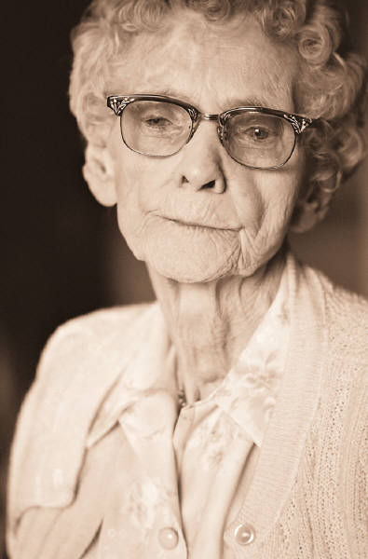
Improve the client journey
…the right piece of equipment
……. at the right time
with the least amount of duplication of assessment….

Slide 8
Learning Objectives
Understand the background to the MOH Equipment and Modifications Improvement Programme and Service Accreditation
Gain an understanding of equipment support services and the roles and responsibilities of Service Accreditation
To leave today with a practical understanding of how Service Accreditation can impact positively on the clients you work with

Slide 9
Training Process
Session 1 – clinical component : 90 mins
Session 2- administrative component: 60 mins
Face to face support from your designated Occupational Therapy or Physiotherapy Supervisor – discuss a minimum of 2 applications with your supervisor.

Slide 10
Session 1
Reason for training
Eligibility criteria for permanent equipment
Clinical reasoning for the provision of equipment
Questions

Slide 11
Why have Service Accreditation?
Minimise risk to client and yourself
Minimise time delay
Reduce the number of health care workers coming in to a person’s life / home
Make the best use of staff resources
It fits within several disciplines’ assessments

Slide 12
Current Practice
Occupational Therapists (OT) are accredited under the Accreditation Framework to recommend personal care and household management equipment for disabled people with long term equipment needs
Physiotherapists (PT) are accredited under the Accreditation Framework to recommend walking aids for disabled people with long term equipment needs
Clients who need long term personal health, household management or mobility equipment are referred to an OT or PT

Slide 13
What will be different
Clients receive equipment with minimal delay and unnecessary multiple assessments
A range of health care providers such as……..
Home Services Assessors Therapy Assistants
Nurse Specialists Gerontology Social Workers
Occupational Therapist Physiotherapists
……………… will all be able to meet the clients permanent equipment needs at the time the need is identified
Increased work force knowledge on the EMS requirements for applications to recommend long term equipment

Slide 14
MoH Equipment & Modification Services (EMS)
MOH funded equipment to help people with daily living includes items such as:
  Shower stool
  Walking frame
  Bedside commode
A national Service Accreditation List of personal care, household management and mobility equipment is available to assessors.

Slide 15
Order Equipment from
EMS Providers
Accessable
18A Frost Rd
Mt Roskill
Auckland
Accessable covers geographic areas from Meremere northwards.
Enable New Zealand
69 Malden Street
PO Box 4547
Palmerston North 4442
Enable New Zealand covers the entire South Island and the lower and central part of the North Island up to the Bombay Hills.

Slide 16
How do disabled people get equipment?
Clients must have an assessment with an EMS Assessor to:
  Determine the need for equipment
  Discuss funding options which could include self-funding

Slide 17

Application Process
Determine the need for equipment
Select the most cost effective and suitable item
Explain process to client
Client signs relevant forms
Complete MoH List Equipment form
Email or fax to Accessable or Enable New Zealand
Follow Up - ensure equipment is meeting
the client’s need

Slide 18
Guide to Clinical Reasoning and Recommending Equipment

Slide 19
MoH Eligibility Criteria
The client must have a disability as defined by the Ministry of Health:
  “people who have been assessed as having a physical, intellectual or sensory disability (or a combination of these)”
  Will enable the person to return to, remain in or mobilise in the home.

Slide 20


The person
  will have a disability that lasts
  for more than six months
  will have difficulty doing some everyday tasks on their own and need ongoing support
  lives in New Zealand, and is a New Zealand resident or is eligible under a shared funding agreement with another country
  is not eligible for cover and entitlement through ACC

Slide 21
Roles and Responsibilities Assessors will:
Be trained by their DHB
Identify functional limitations and essential need for equipment with the person
Establish the person is eligible for EMS funding
Identify the most cost effective equipment to meet the person’s essential needs and document the rationale in their file

Slide 22
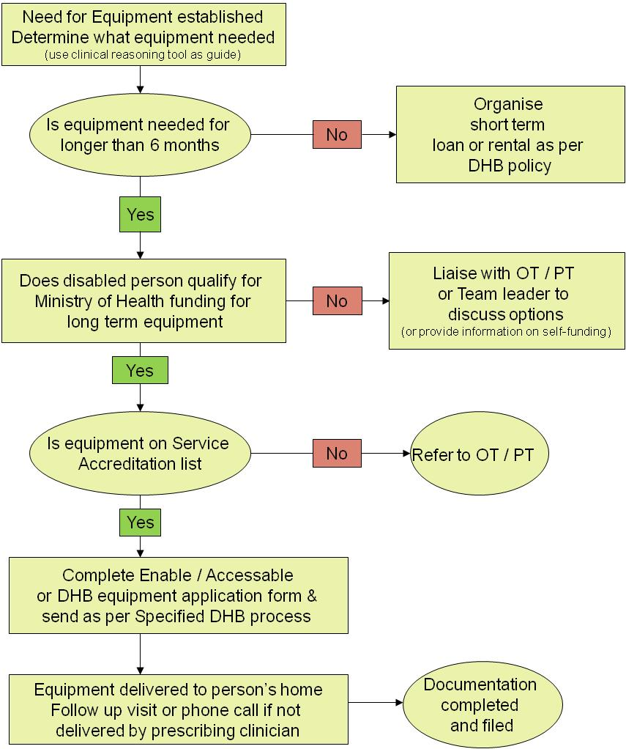
Process for Equipment

Slide 23
MoH Service Accreditation List
Your DHB may put together a “short list” of equipment taken from the MoH Service Accreditation List (may be specific to each DHB)
This may be the most frequently recommended equipment from the MOH Service Accreditation List that is relevant to your service
Is covered in your training via case study and practical experience
Quick reference card for easy use

Slide 24
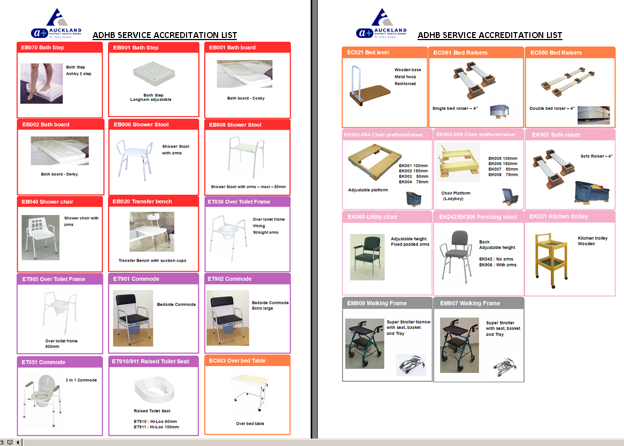
Example - ADHB Service Accreditation List

Slide 25
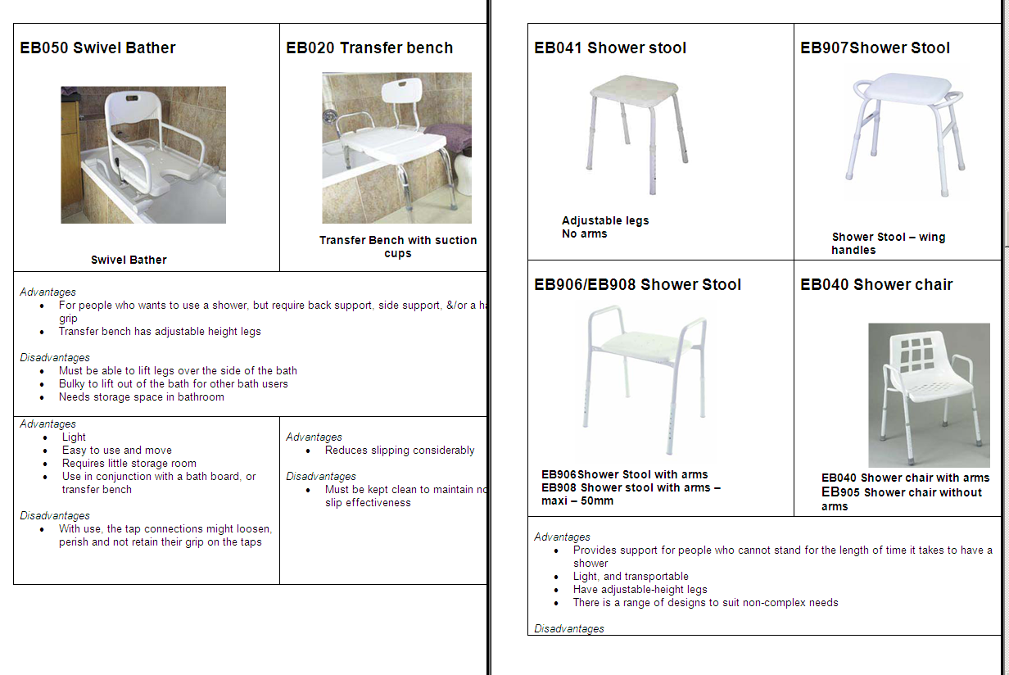
Example – from CMDHB Equipment List

Slide 26
Case examples and questions
You may choose to have pieces of equipment on display or simply use your DHB Service Accreditation List to promote group discussion
An equipment practical is held in the next session and reviews:
  the advantages and disadvantages of the items
  set up and features
  general advice and education.

Slide 27
Case examples to Support
Service Accreditation
The following 4 cases are designed as a resource that can be used to raise awareness of service accreditation and demonstrate how services might be delivered when working to the principles of service accreditation
It should be noted these cases are not prescriptive but are community examples to support learning and development of clinicians as they familiarise themselves with the training module

Slide 28
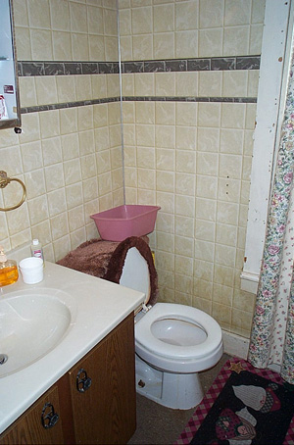
Case 1
A 65 year old man presents with slow mobility due Parkinson’s Disease. He lives with his son. He needs to use the toilet often. He struggles to get on/off the low toilet. He is also has difficulty standing in a large shower box
What pieces of equipment may be useful for this person?
- shower stool?
- raised toilet seat or an over toilet frame?
- a 3 n 1 commode for the toilet and the bedroom?
- rails beside the toilet may be an option?
Is it appropriate for you to apply for the equipment?
- shower stool ( yes)
- toilet equipment ( yes)
- advise family to install a rail beside toilet

Slide 29
Case 2
A 52 year old lady with Rheumatoid Arthritis. She is unable to stand long enough at the kitchen bench to prepare her meals but wishes to be as independent as possible. She mobilises with a walking frame without a seat.
Compare the use of a perching stool and a walking frame with a seat in this situation. Describe the pros and cons of the two items of equipment
Perching stool
Pro - adjustable in height to work at the kitchen bench
has a backrest and armrests to support posture and transfers
angled seat to allow for perch position to work at the kitchen bench
Con - another piece of equipment to fit into the kitchen space
may need to physically move the stool to and from the kitchen bench for access to kitchen cupboards etc
Walking Frame
Pro- only requires one piece of equipment for mobility and meal preparation if kitchen is compact
has brakes to ensure safe transfers on/off seat
wider seat size for a larger person
Con- seat is not adjustable in height so may be too low for transfers on/off

Slide 30
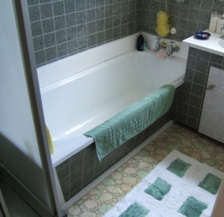
Case 3
A tall 70 year old man referred to District Nurse for a wound sustained in a fall. He presents with bilateral OA hips and mild confusion and memory loss. He lives with his wife who is petite. He mobilises with a shuffling, painful gait and has difficulty with bed, toilet and chair transfers. His wife has to assist him with the shower over the bath.
What pieces of equipment may be useful for this person?
- there is a range of equipment options so he needs a full functional and environmental assessment
Is it appropriate for you to apply for the equipment?
- if there was an urgent need for a particular item of equipment for safety yes, and refer to the appropriate service
And/or what referrals could you consider to other services?
- Occupational therapy to assess the home environment
- Physiotherapy to assess his mobility
- Needs Assessment to assess for long term personal care support

Slide 31
Case 4
A 76 year old lady with osteoarthritis. She lives alone and has some difficulty getting into bed as her bed is too high. She also struggles to manage the sit to stand off the bed. The family would like her to have a hospital bed. What do you do?
  Trial a bed lever
  Suggest the family lower the bed height by removing castors or changing length of bed legs
  Check if there is another bed in the house which may be a more suitable height
  Refer to physiotherapy and /or occupational therapy if none of the above are an option.

Slide 32
Ethical dilemmas
“To give or not to give that is the question”
Challenges
  Palliative
  Meeting patients expectations
  Our expectations of our patients
  Spending the Ministry’s money
  Do we treat rich and poor the same?

Slide 33
Specialised Assessor Training
QUIZ
Clinical Part

Slide 34
Eligibility criteria for equipment to meet long-term needs
Essential / desirable
Enable patient to return to / remain / mobilise in and around the home
Low cost items only when patient provides Proof of Special Needs Grant from Work and Income.
6 month need
  Rehab
  Short term palliative
MOH not ACC

Slide 35
Equipment list
Items on the MoH Service Accreditation Equipment list:
  If you are sure you identified the correct item: apply for it
  If you are not sure what item to choose: discuss with OT
Sliding sheets, type:
  Single: USL medical - slip slide sheet
  Double: Cubro - economy sliding sheet
  You need 2 slide sheets, they don’t come in pairs
Walking sticks: tricky……
  $4,- at dollar shop
  Better quality at pharmacy
  On list have special handle

Slide 36
Bath Boards
What feature does a bath definitely need to fit a bath board safely?
What else does your client need when you organise a bath board?
What feature does a bath definitely need to fit a bath board safely?
  A one inch lip (2,5 cm) at each side of the bath
What else does the person need when you organise a bath board?
  A detachable shower rose

Slide 37
Shower Stools and Chairs
Name two advantages of a shower stool over a shower chair.
  Smaller
  More active position, so easier to wash one self

Slide 38
Toilet Seats and Frames
When would you consider for a raised toilet seat instead of an over toilet frame (OTF)?
  When the patient has a hemiplegia and would tip the OTF
  When the patient is unable to use arms with transfer (RA, ..)
  When the patient only needs that little extra height for a safe transfer and wants to be able to take the RTS to places he visits
  When the drain is in the way of a leg of the OTF
  When the client already has a rail on the wall

Slide 39
Chair Raisers
Your client needs his chair raised. What equipment would you use in case of a:
Ski-type legs
  EK005 chair platform (lazy boy)
Rocking chair without legs or frame
  Not able to raise safely
Lounge chair without legs or frame
  EK001 chair platform
Lounge chair with 4 short feet
  EK001 chair platform
Lazy boy chair with metal frame
  Big softy (discuss with OT or assistant)

Slide 40
Raised Seat Height
What is a good height for a raised seat?
  Upper legs horizontal, feet on the floor

Slide 41
Case 1
You are the first one of the team to see this patient. Following your assessment you advise that he would benefit from a hospital bed with pressure relief mattress, cotsides and a commode chair.
What do you apply for?
  Commode chair
  Hospital bed + cotsides
  Rent: pressure relief mattress
        Hospital bed? (delivery time around 3 weeks)
For what do you need to refer onto another discipline?
  Pressure relief mattress; only OT

Slide 42
Case 2
Your patient had a stroke 3 weeks ago and struggles to walk indoors and get off the toilet.
What do you apply for?
  Nothing
  Loan OTF if able to lean on the affected side
  Loan RTS if unable to lean on affected side
What else do you want to organise?
  PT referral for mobility Ax and transfer Ax

Slide 43
Case 3
Your patient has a shub and finds it difficult to get in for his shower.
What options do you have?
  Refer to OT
  Refer to OT
  Refer to OT

Slide 44
Case 4
Your patient is slightly unbalanced when standing in the shower box. She already has 2 rails and there is not enough space to sit down in the shower. She is afraid of slipping and falling even though she has a carer coming in to help her.
What can you do to improve the situation?
  Provide non slip mat
  (measure the size of the floor of the shower box and Accessable will cut the mat to size)

Slide 45
Case 5
Your patient is a 76 year old lady with osteoarthritis. She lives alone and has some difficulty to get out off bed, which is already a bit high for her. When you see her getting off the bed you notice that she struggles with sit to stand. The family insists she gets a hospital bed. Your patient also mentions she has sore skin on her shoulders and hips at the end of the night. She didn’t see any discoloration when she looked for it.
What do you do?
  Trial bed lever
  Consider bed raisers
  Supply EC030 Mattress Overlay (after patient scored below 5 on Waterlow score)

Slide 46
Case 6
Your patient is a 79 year old man, who is limited in mobility due to gout and longstanding leg ulcers. He lives with his son in a small overcrowded house. He needs to use the toilet often. He struggles to get of the low toilet. The family doesn’t want the toilet to be raised because of the young children in the house. Your patient is not able to stand in the shower, which turns out to be a large shower box.
Without looking at the social circumstances, what pieces of equipment could be useful for your patient?
  OTF
  Bedside commode
  Shower stool
  urinal
What equipment are you going to apply for?
  3 in 1 commode

Slide 47
Over Bed Poles
What is the use of an over bed pole?
  move upwards / side-ways in the bed; lift shoulders
What do patients often think they can use over bed pole for and then it turns out this is not the case?
  Transfer out off the bed

Slide 48
Your patient needs an extra long hospital bed with bed pole. Fill in the application form so support staff can send the application to Accessable or Enable New Zealand.
Tick ‘permanent’
EC 102 bed
EC101 extension and mattress extension
EC 211 Mattress
EC130 over bed pole
Tick deliver at clients home
Write ethnicity and diagnosis
Tick disability type
Tick client signed form and you kept rationale in file
Tick if you gave any of the other forms; could be send out by admin

Slide 49
Please fill in questionnaire after training
OT to give correct answers
Count scores before and after
Handover questionnaire to receive certificate

Slide 50
Example of Training
Session2

Slide 51
Service Accreditation Training
Session 2
Administrative and Practical Component

Slide 52
Learning Objectives
To be competent with documentation and communication processes for the recommendation and application for equipment

Slide 53
MoH List Equipment Form
All information must be completed and all boxes checked
Fax or e-mail MoH List Equipment form to relevant EMS provider (Accessable or Enable)
Keep a copy of the application form in the clinical file or record
Document application for equipment in the clinical record and ensure you list your rationale

Slide 54
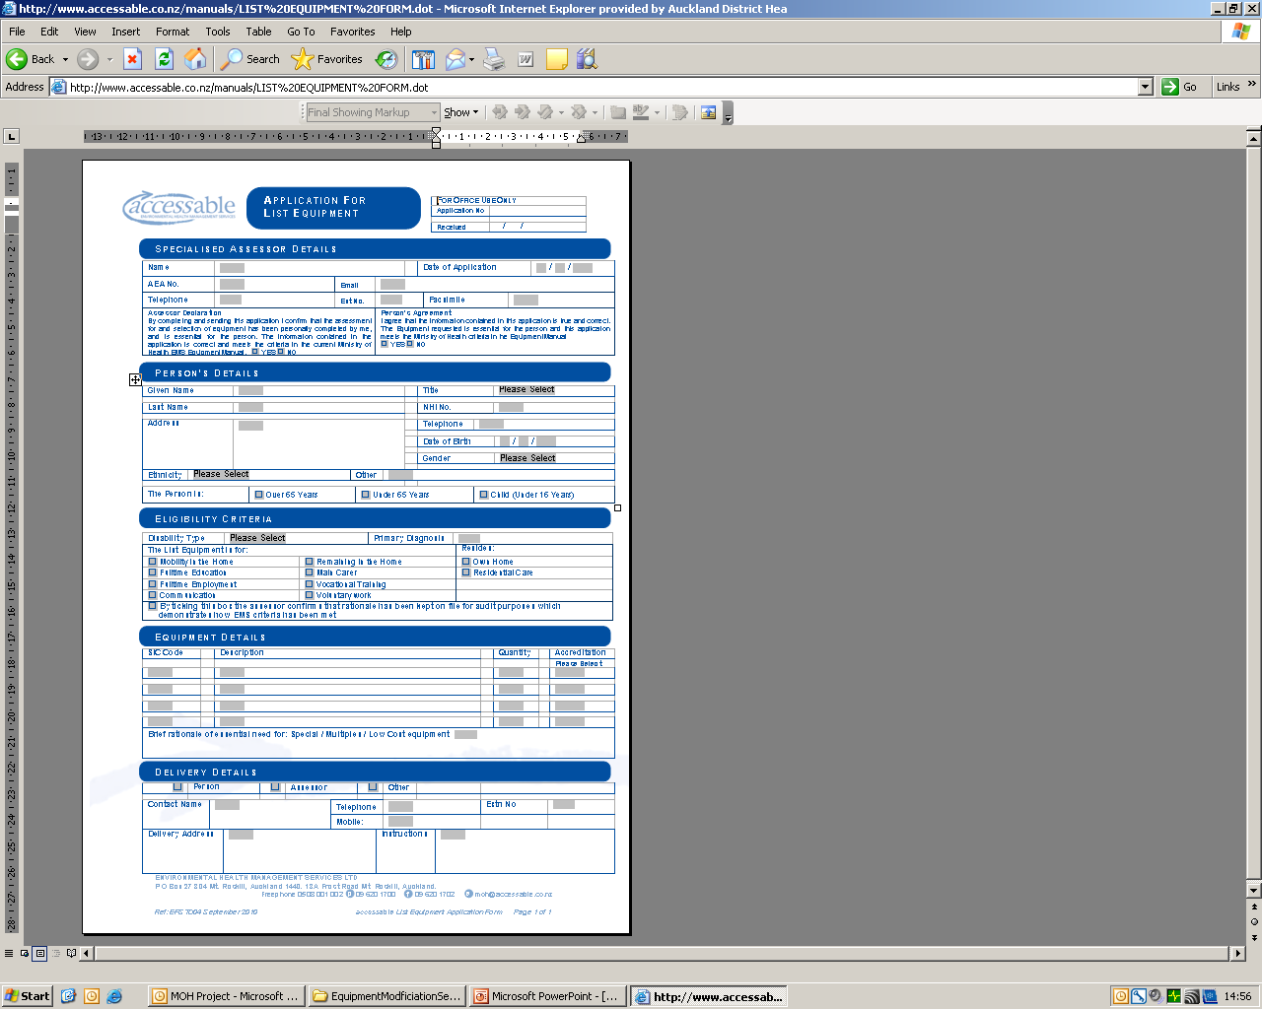
MoH List
Equipment Form
Accessable

Slide 55
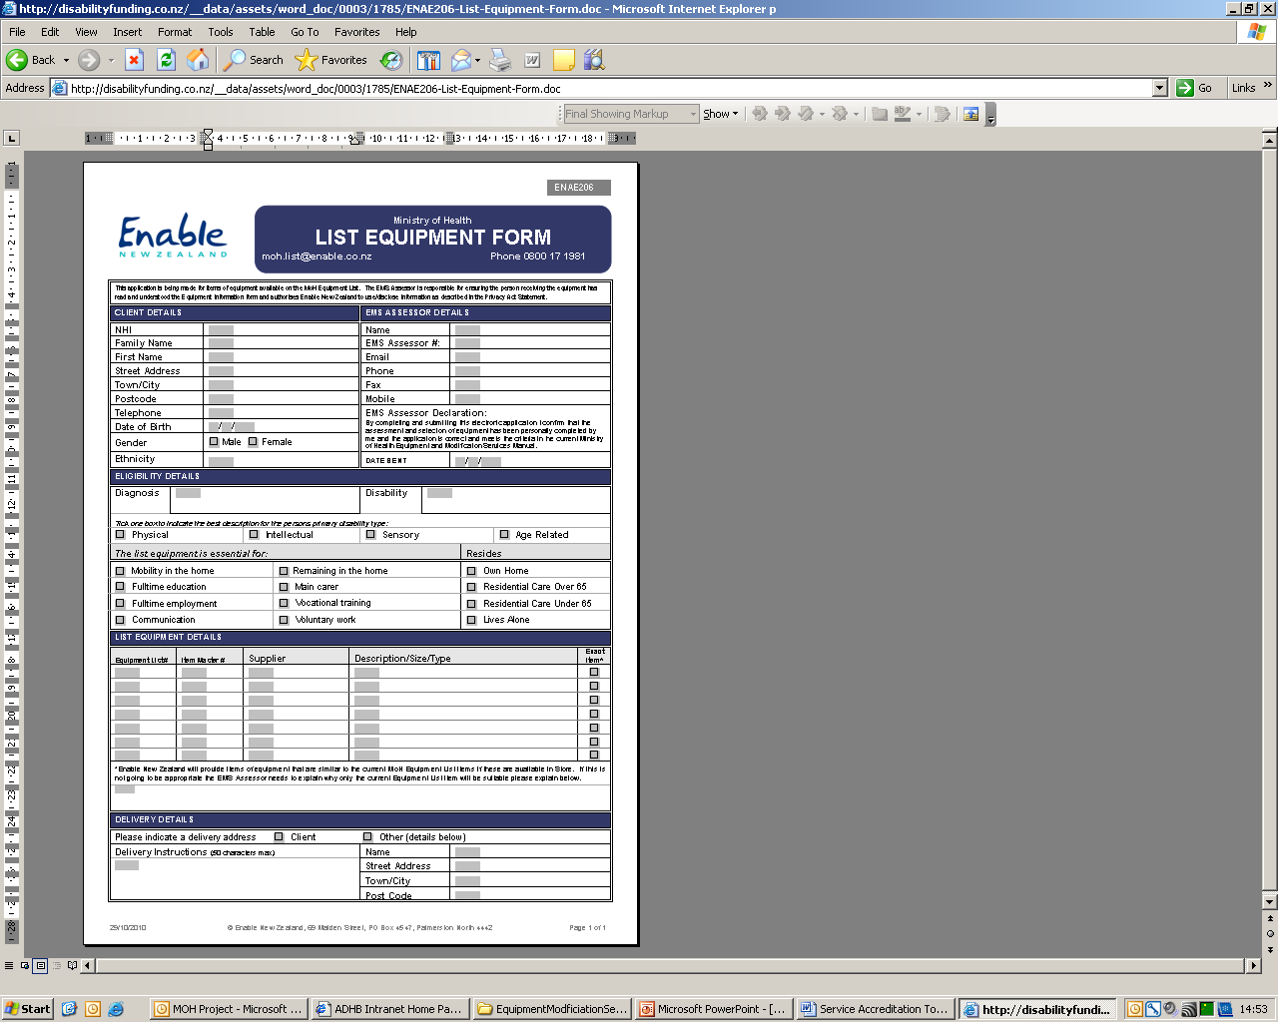
MoH List
Equipment Form
Enable

Slide 56
Equipment Information Form
Client must sign 2 copies.
This is a legal authorisation from the client to allow you to apply for the equipment
A copy must be kept in the clinical record
Client also retains a copy for their own records

Slide 57
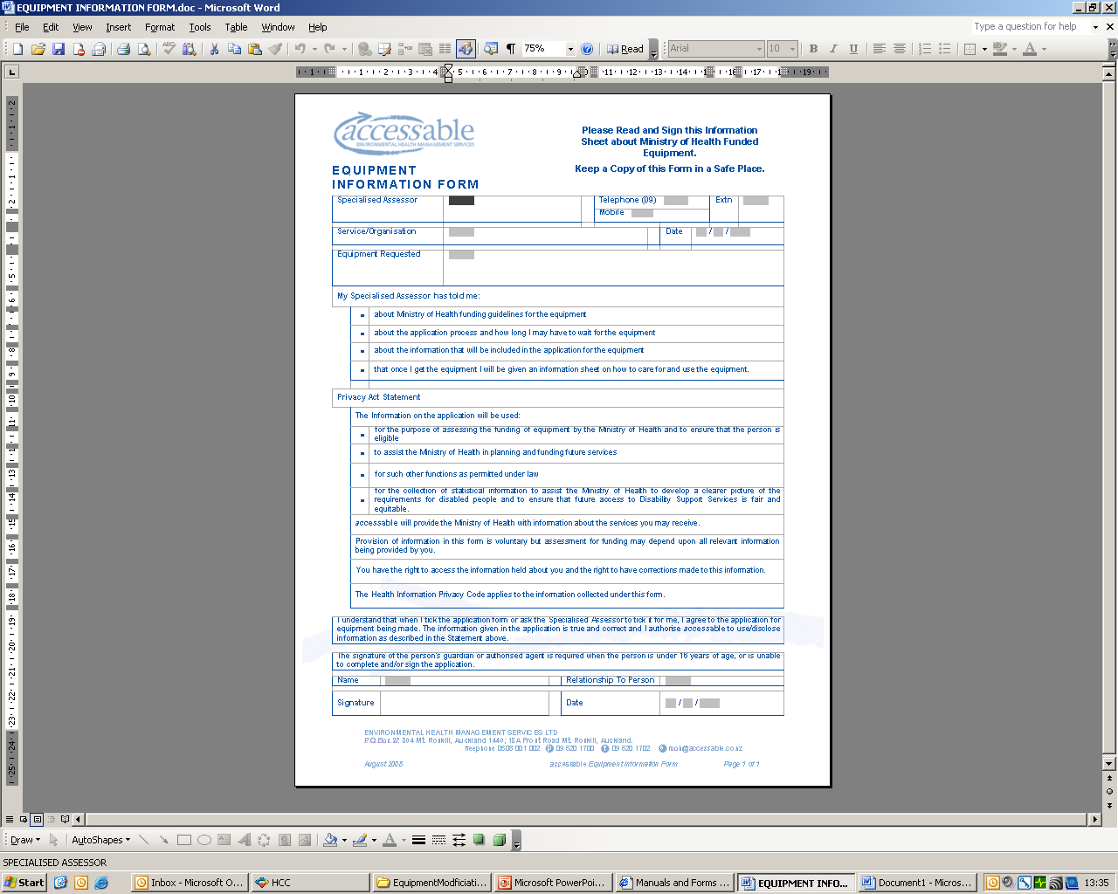
Equipment Information
Form

Slide 58
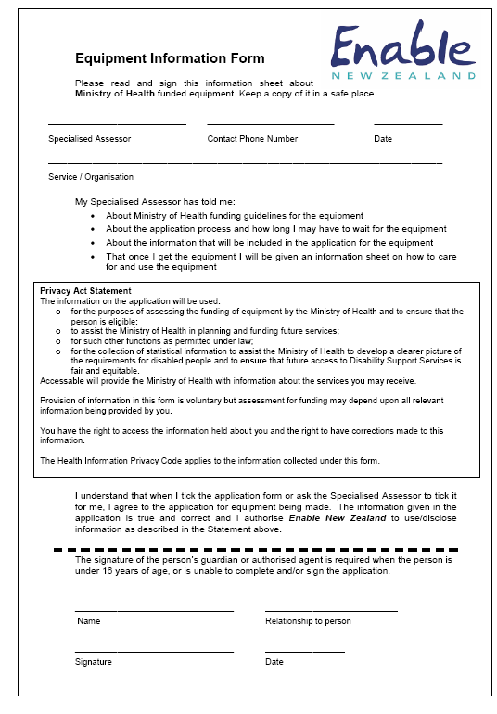
Equipment Information
Form

Slide 59
Care and Use of Equipment Form
Client keeps this form as it has assessor contact details, type of equipment and Accessable or Enable New Zealand contact details in case of repair

Slide 60
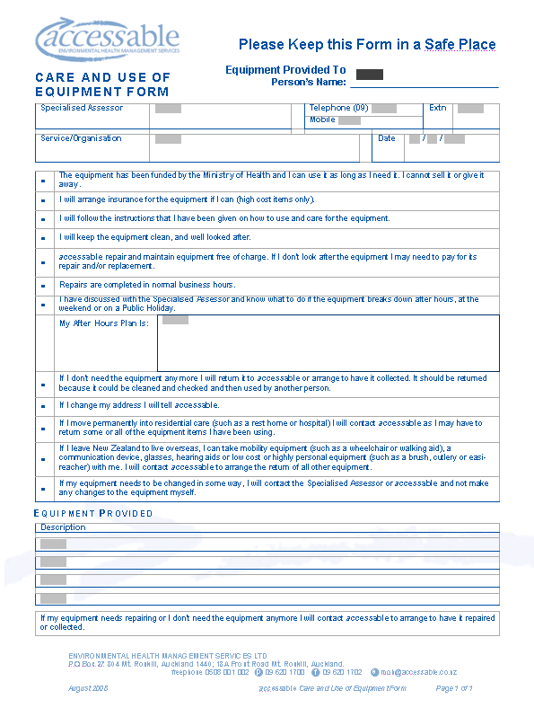
Care and Use of Equipment Form

Slide 61
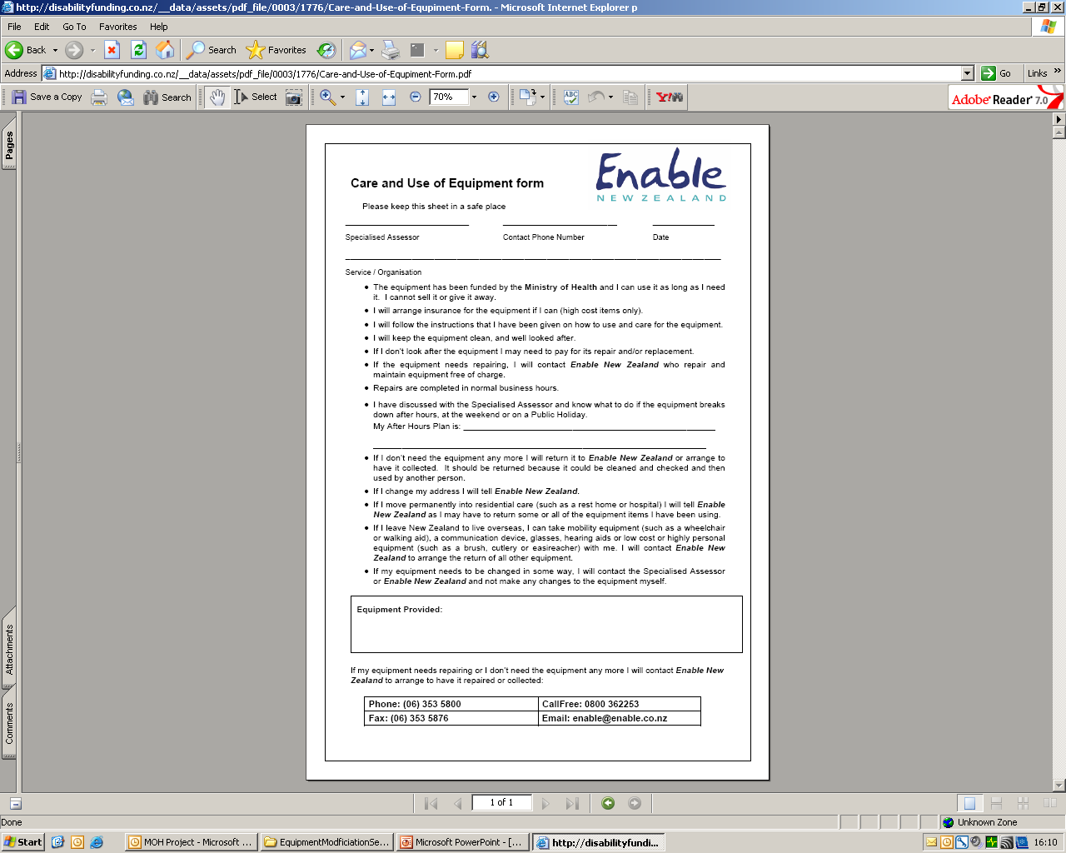
Care and Use of Equipment Form

Slide 62
Notification of Approval
You will receive notification of approval for equipment within 20 working days
If you do not receive notification within the week assume Accessable or Enable New Zealand did not receive your application and phone them and resend if indicated

Slide 63
Example of Training
Session3
Therapy Assistants

Slide 64
Service Accreditation Training

Slide 65
Learning Outcomes
Competence in interpreting the Telephone Assessment Tool and implementing the plan
Understanding of the Risk Tool utilised in the delegation of clients requiring equipment
Understands the Therapy Assistant roles and responsibilities when applying for Service Accreditation List Equipment
Competence in completing the Home Visit Process with clients
Competence with Documentation and Discharge
Competent communication to Allied Health Professional and engagement in Live Supervision

Slide 66
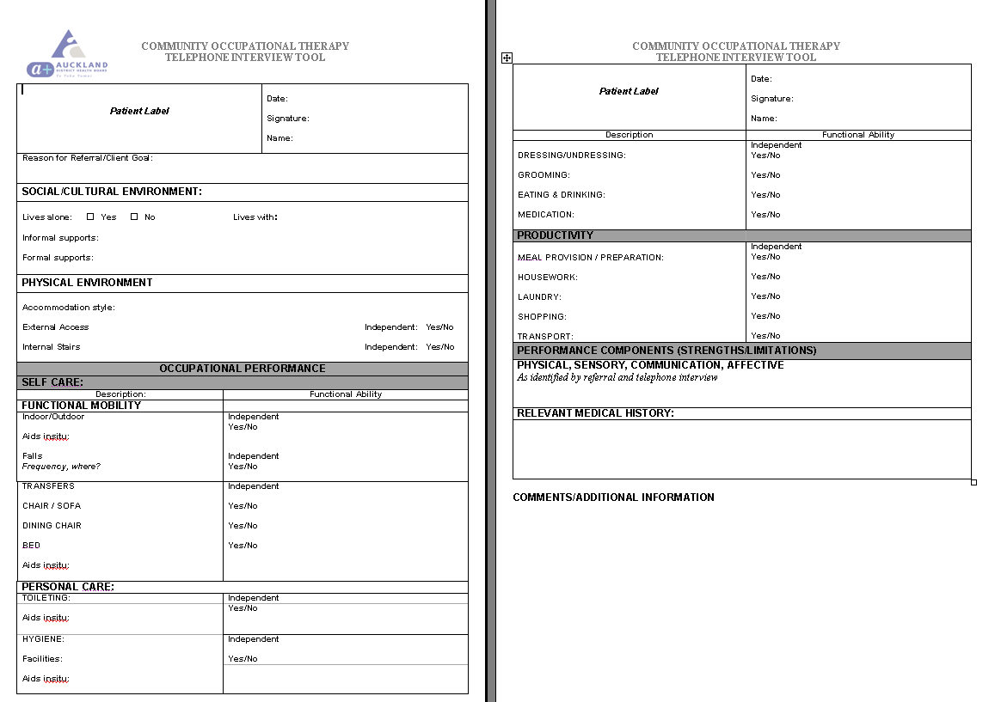

Slide 67
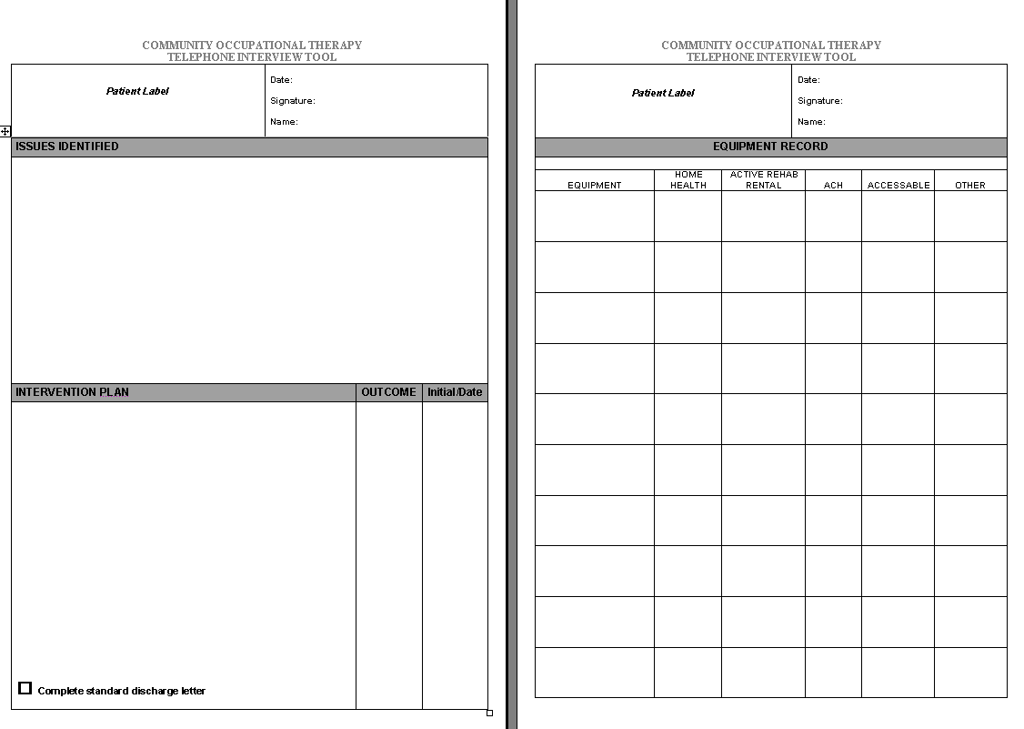

Slide 68
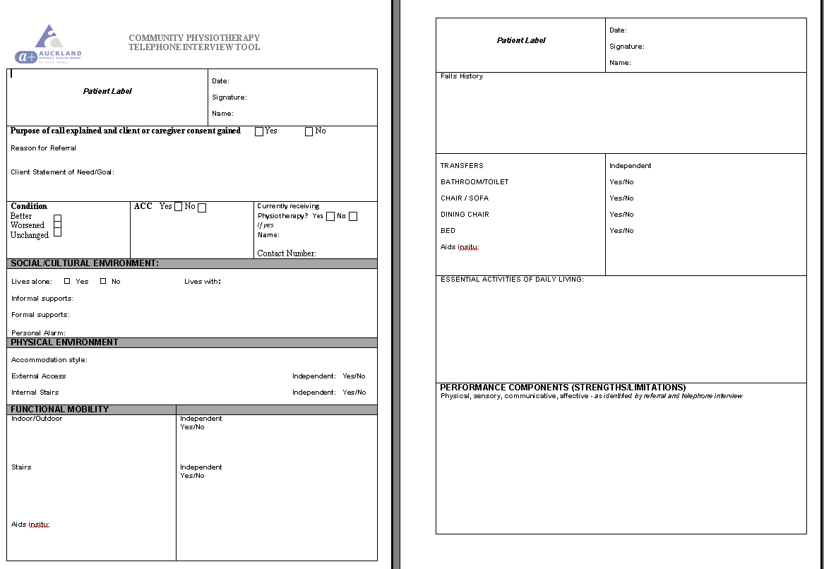

Slide 69
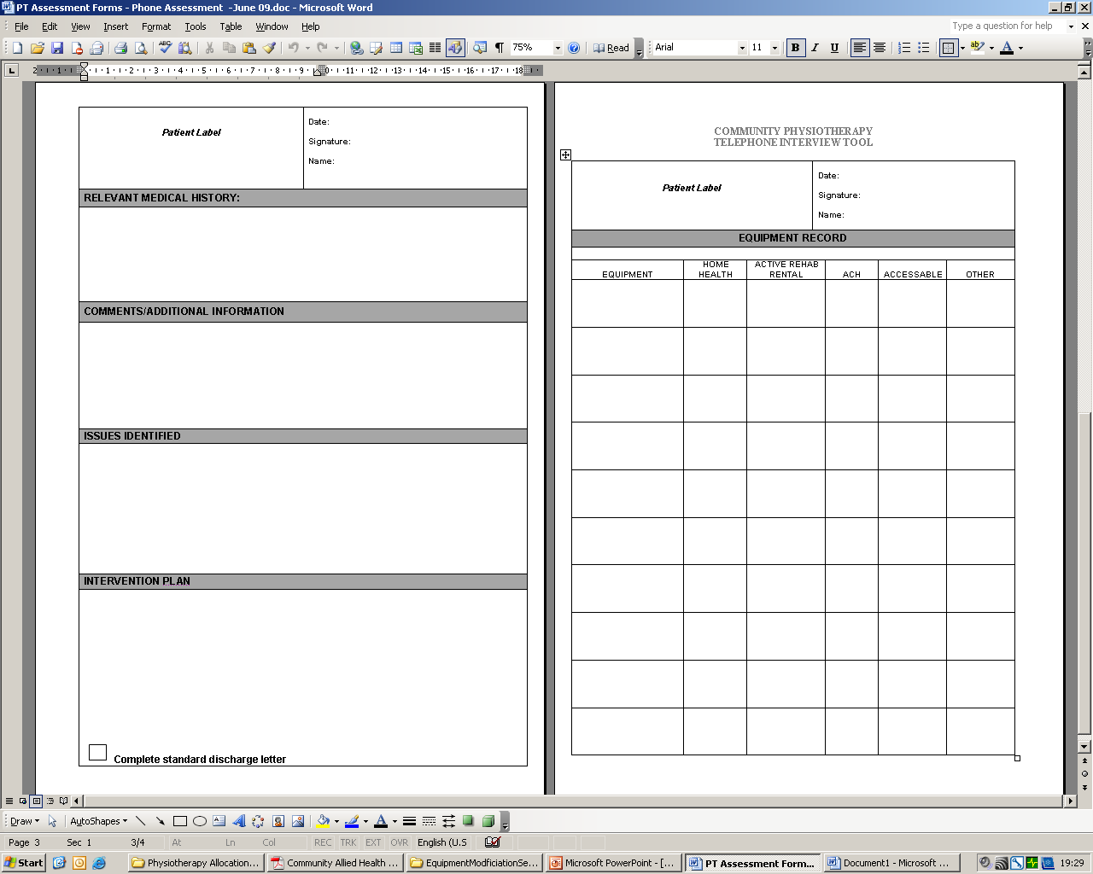

Slide 70
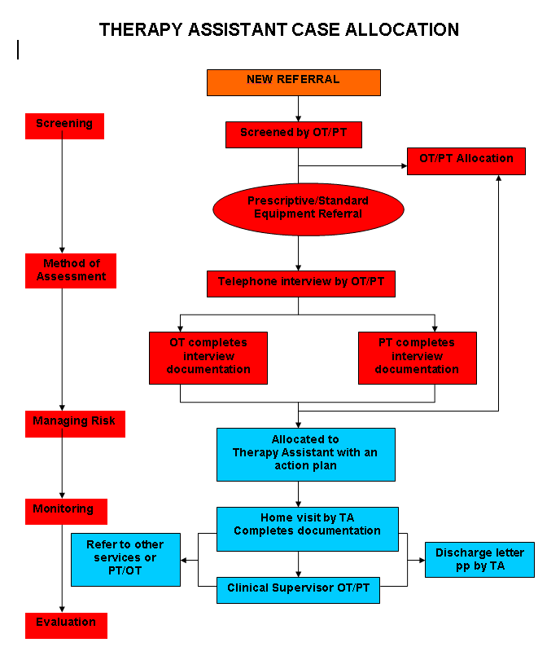
Risk Tool
Red – OT or PT
Blue - TA

Slide 71
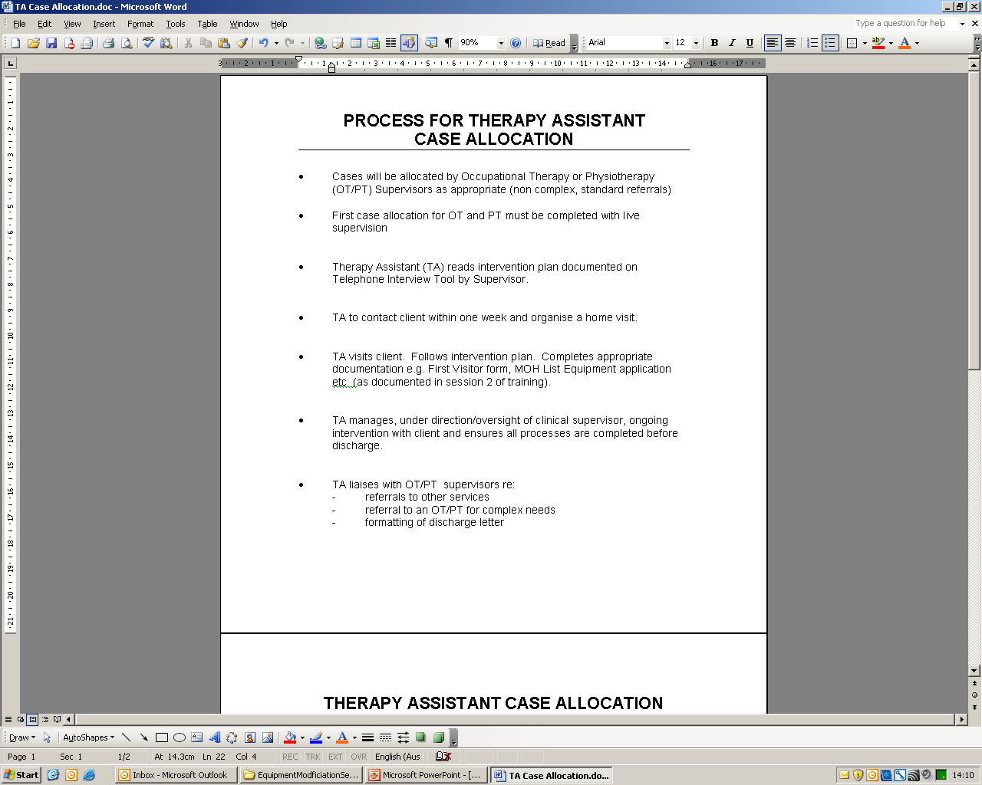
Roles and Responsibilities

Slide 72
Communication
TA accepts responsibility to communicate and liaise with supervisors re:
  any change in client’s presentation
  any concerns regarding client safety
  identification of more complex needs requiring a clinical assessment
  family concerns
  the first allocation to TA for both OT and PT must be completed under live supervision

Slide 73
Documentation and Discharge
TA intervention documented in clinical notes
All MOH list applications completed by TA
Delivery and set up of equipment is managed by TA
At completion of intervention TA follows
discharge process

Slide 74
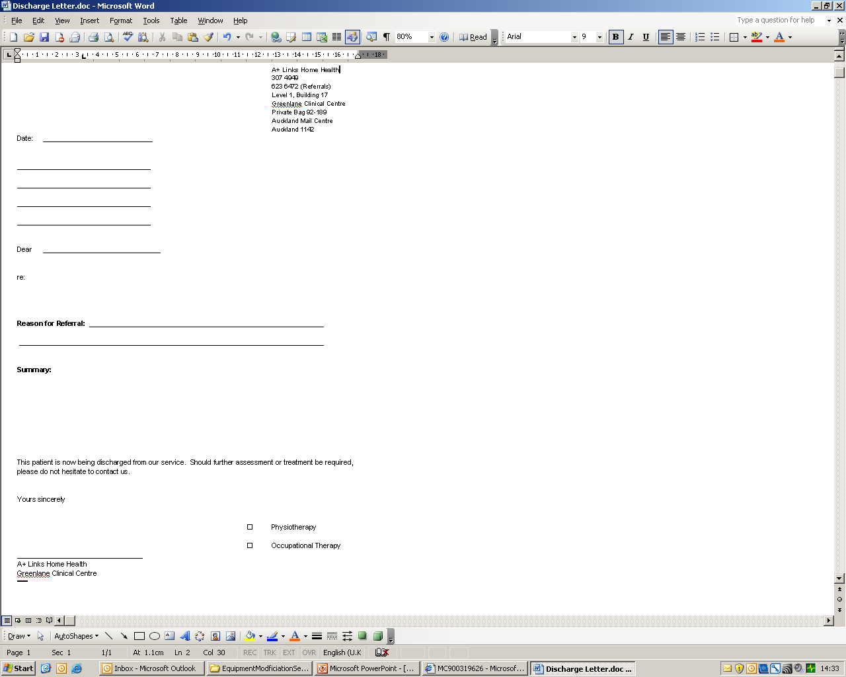
Discharge Letter

